Slide 1

Water Assist Pro
Microcontroller (Team E)
Shihab Ud Doula
Abdullah Al Forkan
Md. Salman Bin Shahid

Slide 2

Goal
To create a Smart IoT device which can detect water moisture and light with help of sensors.
Hardware used:
Microcontroller (Atmega128A)
DC Motor
LED
Breadboard
Sensors (Moisture Sensor and Light Sensor)

Slide 3

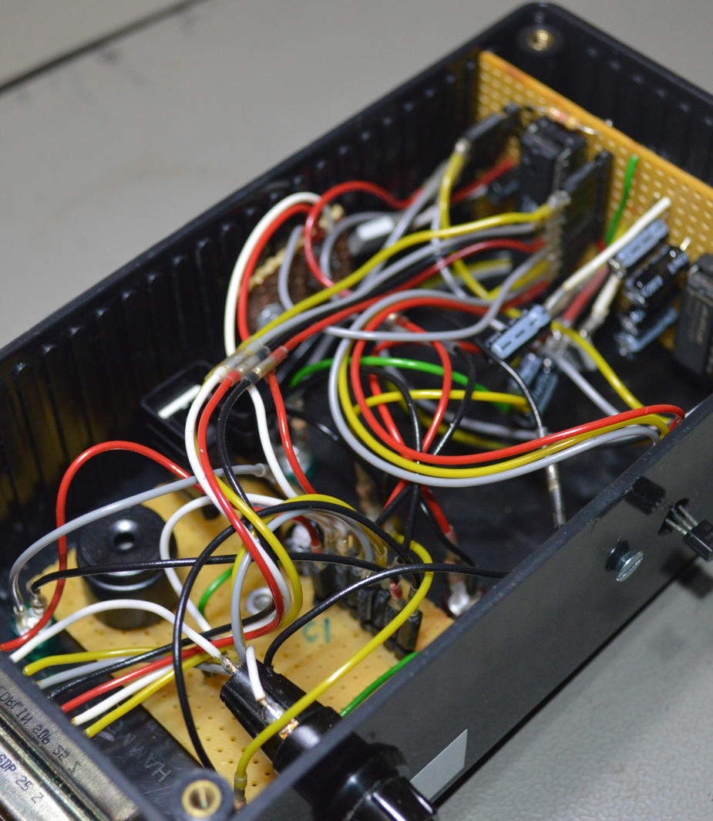
Initial Task to Final rendition
Implementation of components
Higher accuracy
Coding
Testing in real life environment
Easy understanding of the device

Slide 4
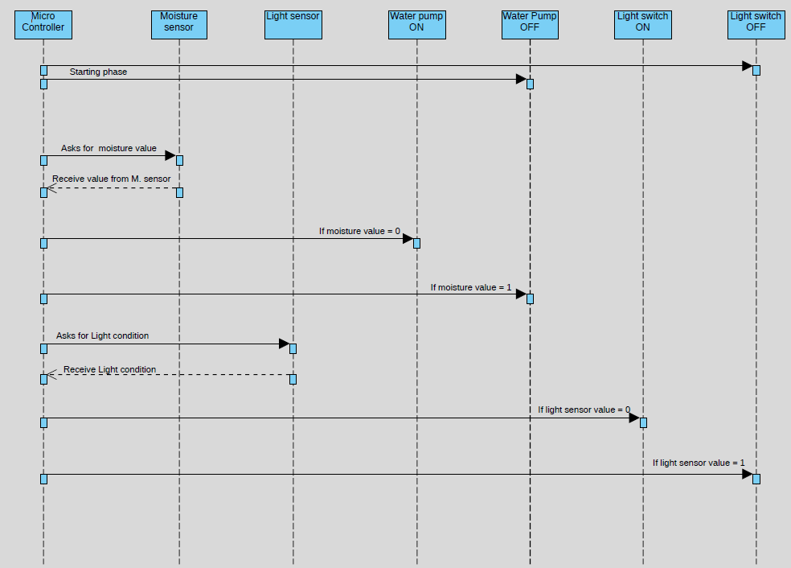
Sequence diagram

Slide 5
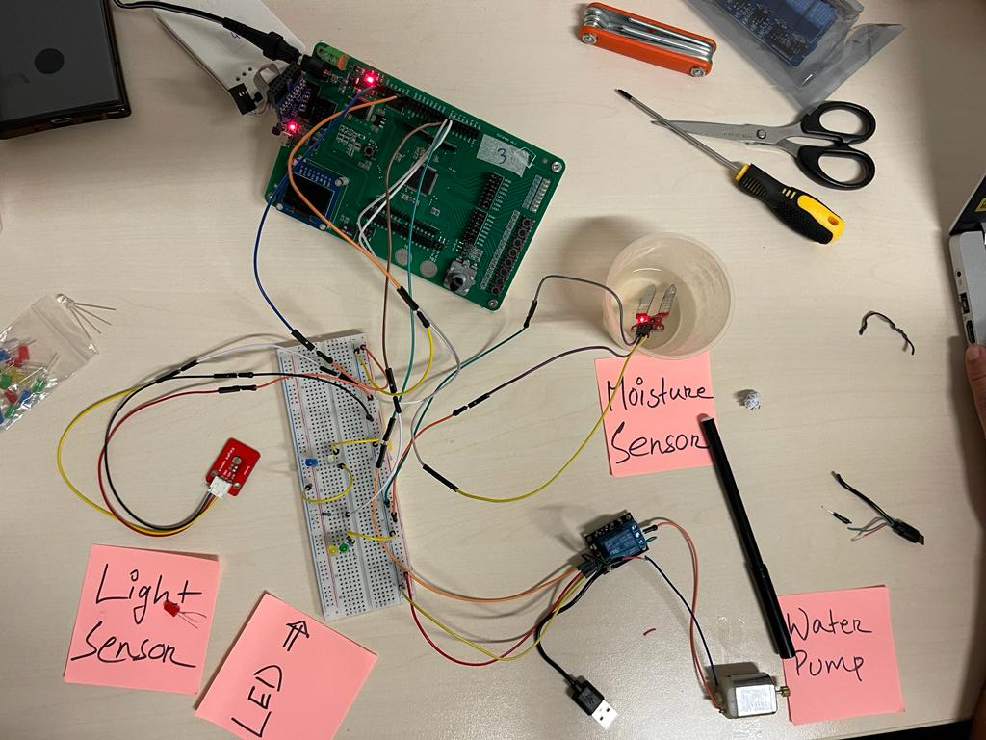
Actual implementations
Pins used for the Water assist pro,
Pin VIN – For voltage Input
Pin GND – For Ground connection
Pin PA0 – As Light switch
Pin PA1 – Connected to motor relay As Water Pump switch
Pin PF0 – For Moisture sensor
Pin PF1 – For Light sensor

Slide 6

Final Code In Microchip
Setting up pin and variables
Coding of moisture sensor and light sensor

Slide 7

Code
int main(void){
int Moisture;
int LightSensor;
DDRA |= (1 << 0); //Output
DDRA |= (1 << 1);
ADC_Init();/* initialize the ADC */
while(1){
Moisture = ADC_Read1();/* Copy the ADC value */
LightSensor = ADC_Read2();
if(LightSensor<900)
{
PORTA |= (1 << 0); //&=~(1 << 0);
}
else
{
PORTA &=~(1 << 0); //|= (1 << 0);
}
if(Moisture<900)
{
PORTA |= (1 << 1); //&=~(1 << 0);
}
else
{
PORTA &=~(1 << 1); //|= (1 << 0);
}
_delay_ms(50);
}
}
#include <avr/io.h>
#define F_CPU 800000000UL
#include <util/delay.h>
#include <stdlib.h>
#include <string.h>
void ADC_Init(){
DDRF &=~(1 << 0); //ADC port as input
DDRF &=~(1 << 1);
ADCSRA = 0x87; //Enable ADC, fr/128 */
}
int ADC_Read1(){
ADMUX = 0x40;/* Vref: Avcc, ADC channel: 0 */
ADCSRA |= (1<<ADSC);/* start conversion */
while ((ADCSRA &(1<<ADIF))==0);/* monitor end of conversion interrupt flag */
ADCSRA |=(1<<ADIF);/* set the ADIF bit of ADCSRA register */
return(ADCW);/* return the ADCW */
}
int ADC_Read2()
{
ADMUX = 0x41;/* Vref: Avcc, ADC channel: 0 */
ADCSRA |= (1<<ADSC);/* start conversion */
while ((ADCSRA &(1<<ADIF))==0);/* monitor end of conversion interrupt flag */
ADCSRA |=(1<<ADIF);/* set the ADIF bit of ADCSRA register */
return(ADCW);/* return the ADCW */
}

Slide 8

Thank you

Slide 9

Questions?

